Slide 1
Duality Theory

Slide 2
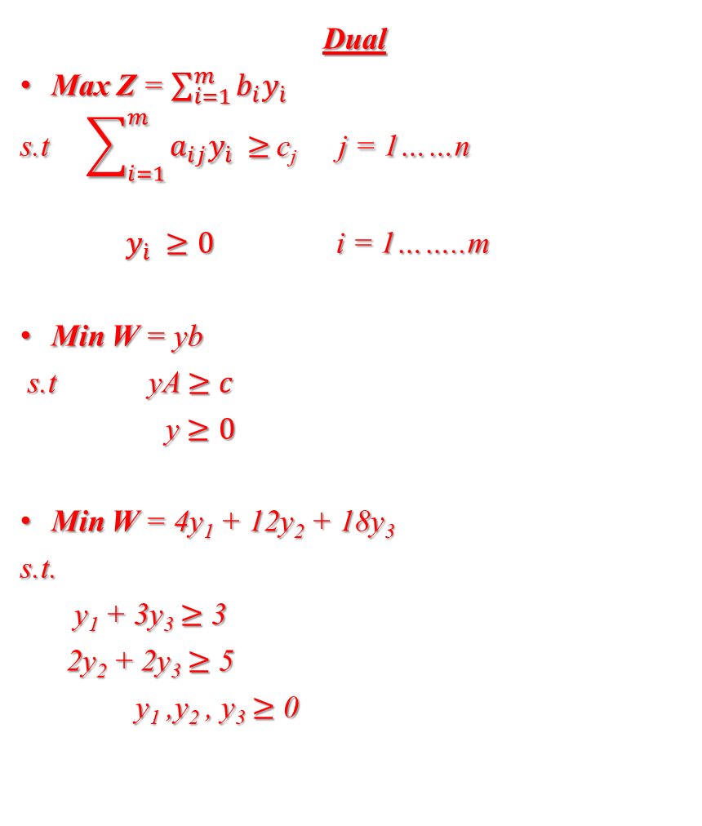
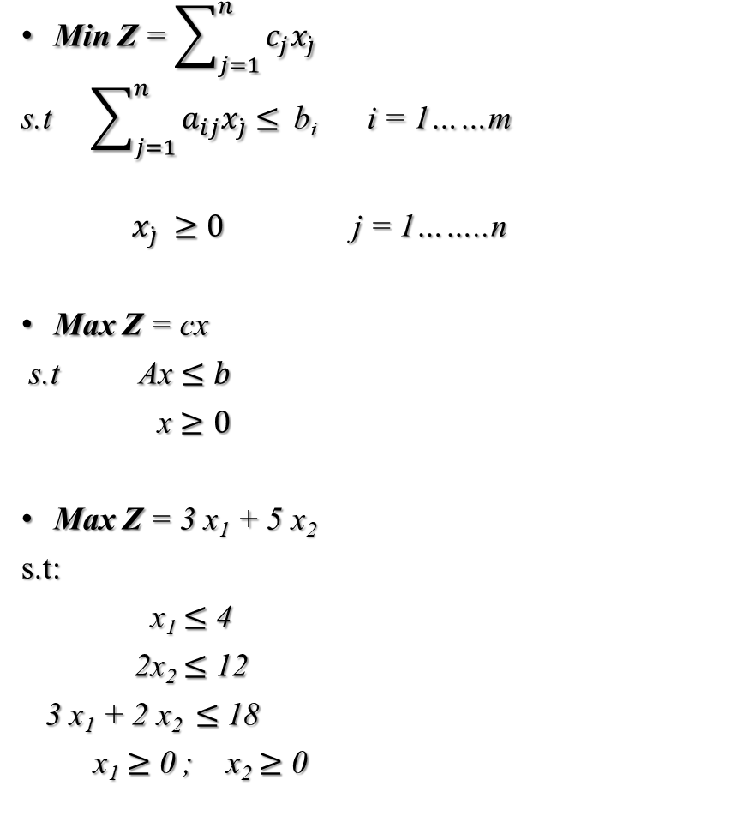
Dual
Max Z = $\sum_{i=1}^{m}{b_{i}y_{\dot{i}}}$
s.t $\sum_{i=1}^{m}{a_{ij}y_{\dot{i}}}$ $≥$c_{j} j = 1……n
$y_{\dot{i}}$ $≥0$ i = 1……..m
Min W = yb
s.t yA $≥c$
y $≥0$
Min W = 4y₁ + 12y₂ + 18y₃
s.t.
y₁ + 3y₃ $≥$ 3
2y₂ + 2y₃ $≥$ 5
y₁ ,y₂ , y₃ $≥$ 0
Min Z = $\sum_{j=1}^{n}{c_{j}x_{\dot{j}}}$
s.t $\sum_{j=1}^{n}{a_{ij}x_{\dot{j}}}$ $≤$ b_{i} i = 1……m
$x_{\dot{j}}$ $≥0$ j = 1……..n
Max Z = cx
s.t Ax $≤b$
x $≥0$
Max Z = 3 x₁ + 5 x₂
s.t:
x₁ $≤$ 4
2x₂ $≤$ 12
3 x₁ + 2 x₂ $≤$ 18
x₁ $≥$ 0 ; x₂ $≥$ 0

Slide 3
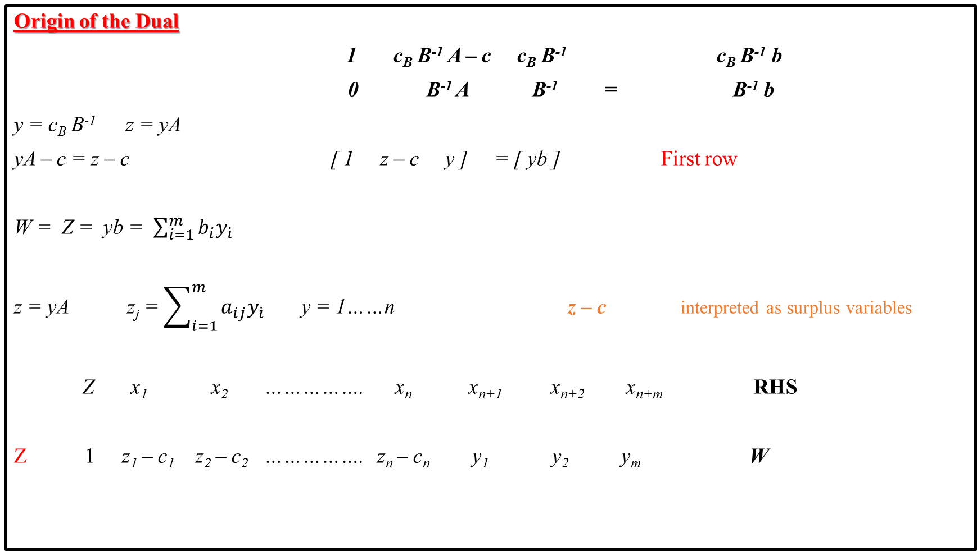
Origin of the Dual
1 c_{B} B⁻¹ A – c c_{B} B⁻¹ c_{B} B⁻¹ b
0 B⁻¹ A B⁻¹ = B⁻¹ b
y = c_{B} B⁻¹ z = yA
yA – c = z – c [ 1 z – c y ] = [ yb ] First row
W = Z = yb = $\sum_{i=1}^{m}{b_{i}y_{\dot{i}}}$
z = yA z_{j} = $\sum_{i=1}^{m}{a_{ij}y_{\dot{i}}}$ y = 1……n z – c interpreted as surplus variables
Z x₁ x₂ ……………. x_{n} x_{n+1} x_{n+2} x_{n+m} RHS
Z 1 z₁ – c₁ z₂ – c₂ ……………. z_{n} – c_{n} y₁ y₂ y_{m} W

Slide 4
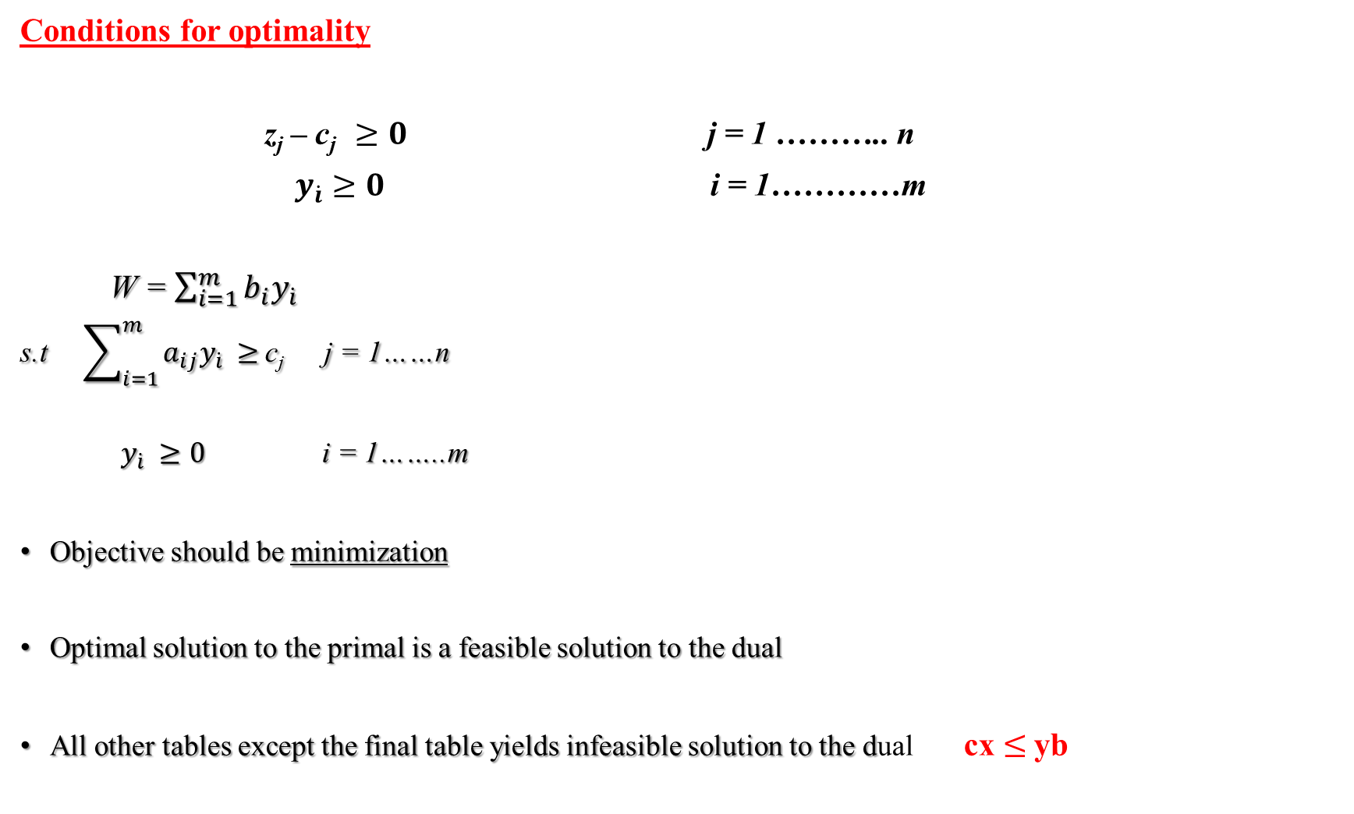
Conditions for optimality
z_{j} – c_{j} $≥0$ j = 1 ……….. n
${ y}_{\dot{i}}$ $≥0$ i = 1…………m
W = $\sum_{i=1}^{m}{b_{i}y_{\dot{i}}}$
s.t $\sum_{i=1}^{m}{a_{ij}y_{\dot{i}}}$ $≥$c_{j} j = 1……n
$y_{\dot{i}}$ $≥0$ i = 1……..m
Objective should be minimization
Optimal solution to the primal is a feasible solution to the dual
All other tables except the final table yields infeasible solution to the dual cx $≤$yb

Slide 5
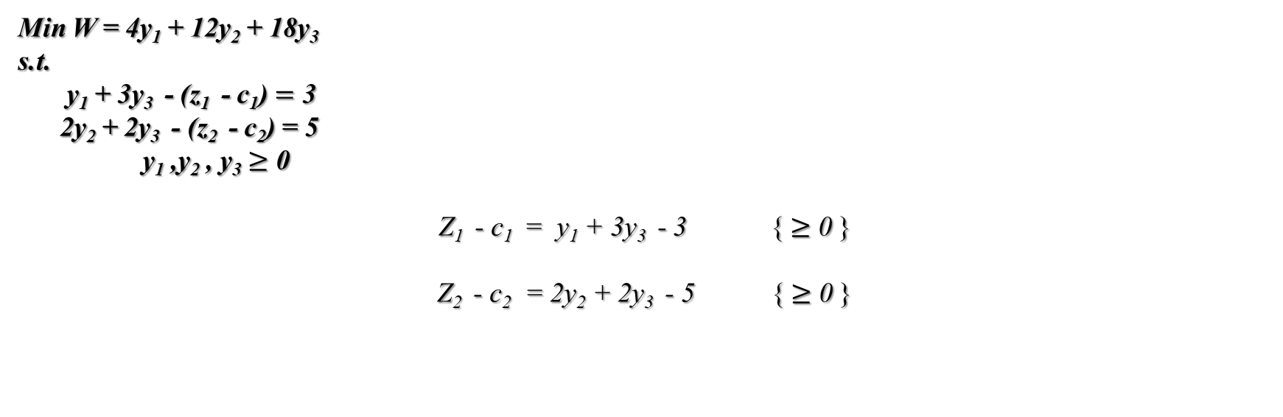
 | Primal | Dual
Iteration | Row 0 | y₁ y₂ y₃ Z₁ - c₁ Z₂ - c₂ | W
0 | -3 -5 0 0 0 | 0 0 0 -3 -5 | 0
1 | -3 0 0 5/2 0 | 0 5/2 0 -3 0 | 30
2 | 0 0 0 3/2 1 | 0 3/2 1 0 0 | 36
Min W = 4y₁ + 12y₂ + 18y₃
s.t.
y₁ + 3y₃ - (z₁ - c₁) $=$ 3
2y₂ + 2y₃ - (z₂ - c₂) = 5
y₁ ,y₂ , y₃ $≥$ 0
Z₁ - c₁ = y₁ + 3y₃ - 3 { $≥$ 0 }
Z₂ - c₂ = 2y₂ + 2y₃ - 5 { $≥$ 0 }

Slide 6
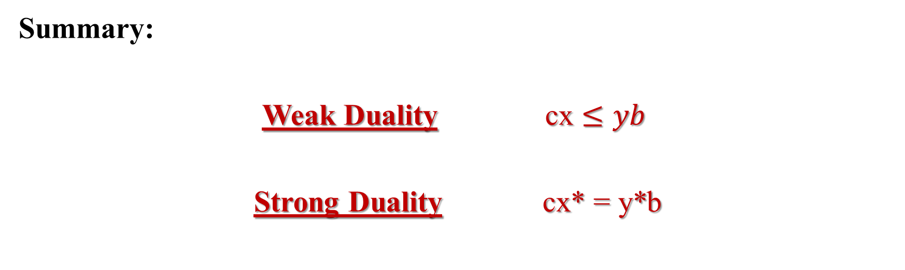
Summary:
Weak Duality cx $≤yb$
Strong Duality cx* = y*b

Slide 7
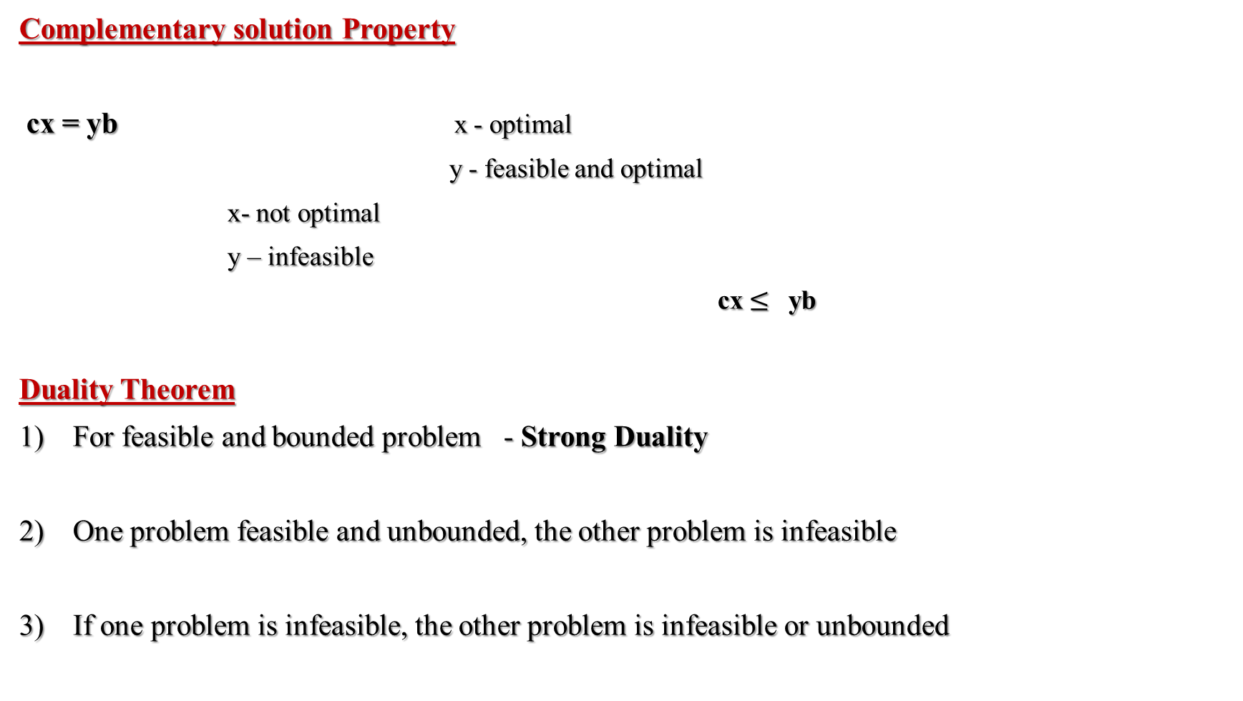
Complementary solution Property
cx = yb x - optimal
y - feasible and optimal
x- not optimal
y – infeasible
cx $≤$ yb
Duality Theorem
For feasible and bounded problem - Strong Duality
One problem feasible and unbounded, the other problem is infeasible
If one problem is infeasible, the other problem is infeasible or unbounded

Slide 8
Complementary slackness
Primal Dual
Basic Non-basic (m variables)
Non-basic Basic (n variables)
Example:
feasible ?
Primal |  |  | Dual
(0,0,4,12,18) | Yes | 0 | No | (0,0,0,-3,-5)
(4,0,0,12,6) | Yes | 12 | No | (3,0,0,0,-3)
(6,0,-2,12,0) | No | 18 | No | (0,0,1,0,-3)
(4,3,0,6,0) | Yes | 27 | No | (-9/2,0,5/2,0,0)
(0,6,4,0,6) | Yes | 30 | No | (0,5/2,0,-3,0)
(2,6,2,0,0) | Yes | 36 | Yes | (0,3/2,1,0,0)
(4,6,0,0,-6) | No | 42 | Yes | (3,5/2,0,0,0)
(0,9,4,-6,0) | No | 45 | Yes | (0,0,5/2,9/2,0)

Slide 9

Finding solution using complementary slackness
(4,6,0,0,-6) Primal
x₃, x₄ Non - basic
x₁, x₂, x₅ Basic
z₁ - c₁ z₂ - c₂ y₃ Non-basic = 0
y_{1 ,} y₂ Basic
y₁ + 3y₃ - (z₁ - c₁) $=$ 3
2y₂ + 2y₃ - (z₂ - c₂) = 5
y₁ = 3 y₂ = 5/2

Slide 10


Adapting to other Primal forms
Standard form
Min. yb Max. -yb
s.t. yA $≥$ c s.t - yA $≤$ -c
y $≥$ 0 y $≥$ 0
Standard form
Max. cx
s.t. Ax $≤$ b
x $≥$ 0
Dual
Min. -cx
s.t. - Ax $≥−b$
x $≥0$

Slide 11


SOB Method (Sensible, Odd, Bizarre Method)
Max - Z = - 0.4x₁ - 0.5x₂
s.t. 0.3x₁ + 0.1x₂ $≤ 2.7$ (S)
0.5x₁ + 0.5x₂ $= 6$ (O)
0.6x₁ + 0.4x₂ $≥ 6$ (B)
x₁ $≥0$ (S)
x₂ $≥0$ (S)
Min 2.7y₁ + 6y₂ + 6y₃’
s.t. y₁ $≥$ 0
y₂ unrestricted
y₃’ $≤$ 0
0.3y₁ + 0.5y₂ + 0.6y₃’ $≥$ -0.4 (S)
0.1y₁ + 0.5y₂ + 0.4y₃’ $≥$ -0.5 (S)

Slide 12


SOB Method (Sensible, Odd, Bizarre Method)
Min Z = 0.4x₁ + 0.5x₂
s.t. 0.3x₁ + 0.1x₂ $≤ 2.7$ (B)
0.5x₁ + 0.5x₂ $= 6$ (O)
0.6x₁ + 0.4x₂ $≥ 6$ (S)
x₁ $≥0$ (S)
x₂ $≥0$ (S)
Max 2.7y₁ + 6y₂ + 6y₃’
s.t. y₁’ $≤$ 0
y₂’ unrestricted
y₃ $≥$ 0
0.3 y₁’ + 0.5 y₂’ + 0.6y₃ $≤$ 0.4 (S)
0.1 y₁’ + 0.5 y₂’ + 0.4y₃$≤$ 0.5 (S)

Slide 13
Z x₁ x₂ x₃ x₄ x₅ x₆ RHS
Z -1 0 0 0.5 M-1.1 0 -M -5.25
y₁ y₂ y₃

Slide 14
Applications :
No. of constraints (m) > No. of variables (n)
Suppose ‘x’ is a Primal feasible
‘y’ is a dual feasible found by inspection
If cx = yb ‘x’ is optimal (no need to apply simplex)
If cx < yb still yb provides an upper bound

Slide 15
Reddy Mikks Model :
Reddy Mikks produces both interior and exterior paints from two raw materials M₁ and M₂
A market Survey :
Daily demand for interior paint cannot exceed that of exterior paint by more than 1 ton. Also, the maximum daily demand of interior paint is 2 tons
 | Tons of raw material per ton of |  | Maximum daily availabilities
 | Exterior Paint | Interior Paint
Raw material M₁ | 6 | 4 | 24
Raw material M₂ | 1 | 2 | 6
Profit per ton ($1000) | 5 | 4

Slide 16
Graphical Sensitivity Analysis
Changes in the objective coefficients
Changes in the RHS

Slide 17
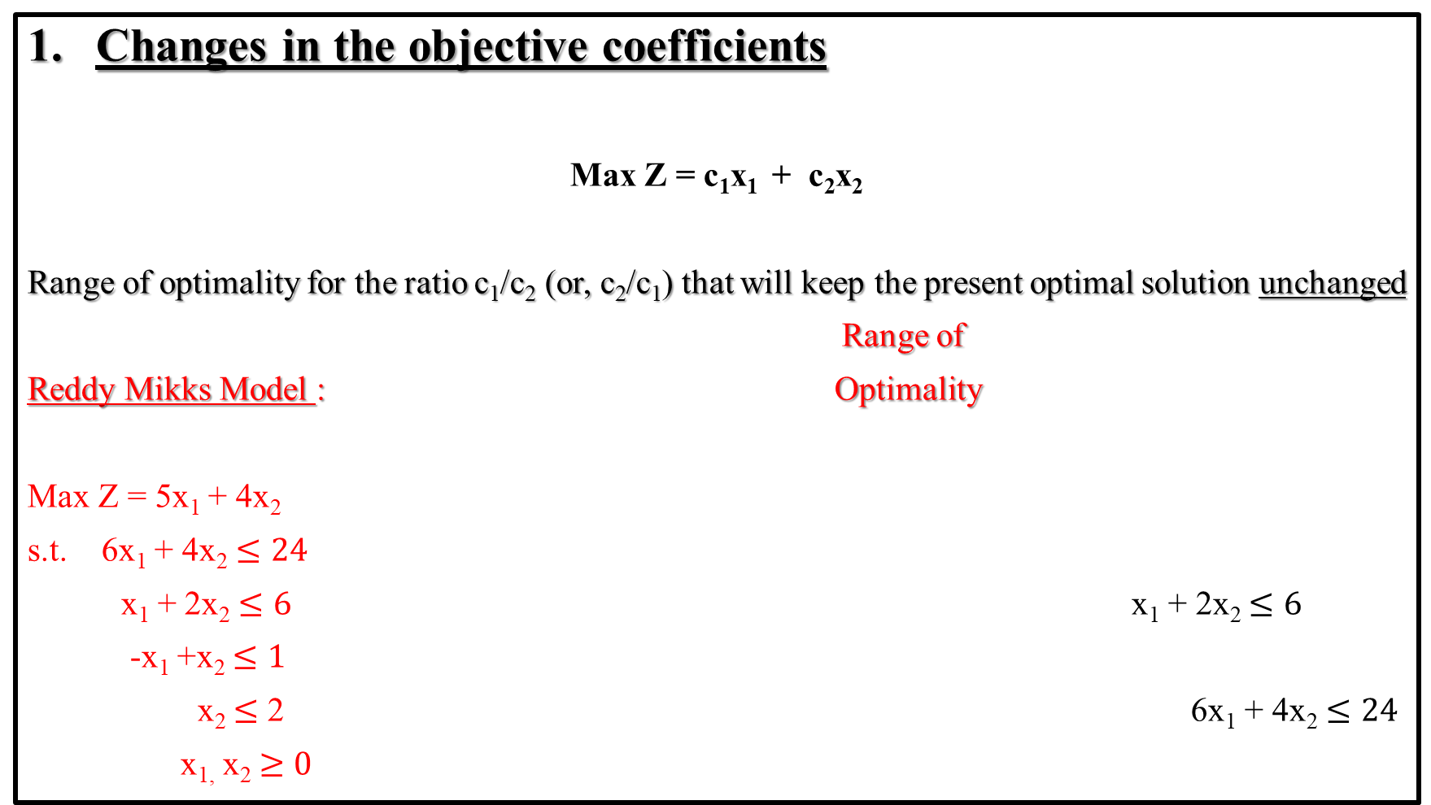
Changes in the objective coefficients
Max Z = c₁x₁ + c₂x₂
Range of optimality for the ratio c₁/c₂ (or, c₂/c₁) that will keep the present optimal solution unchanged
Range of
Reddy Mikks Model : Optimality
Max Z = 5x₁ + 4x₂
s.t. 6x₁ + 4x₂ $≤24$
x₁ + 2x₂ $≤6$ x₁ + 2x₂ $≤6$
-x₁ +x₂ $≤1$
x₂ $≤$ 2 6x₁ + 4x₂ $≤24$
x_{1,} x₂ $≥0$

Slide 18


If c₁ $≠$ 0 $\frac{4}{6}$ $≤ \frac{\text{c}\text{2}}{\text{c}\text{1}}$ $≤$ $\frac{2}{1}$ cannot be horizontal
If c₂ $≠$ 0 $\frac{1}{2}$ $≤ \frac{\text{c}\text{1}}{\text{c}\text{2}}$ $≤$ $\frac{6}{4}$ cannot be vertical
Both applicable in this example
Z = 5x₁ + 4x₂
2 6
Suppose c₂ = 4 fixed
What is the optimality range of c₁ ?
$\frac{1}{2}$ $≤ \frac{\text{c}\text{1}}{\text{c}\text{2}}$ $≤$ $\frac{6}{4}$
$\frac{1}{2} x 4$ $≤ \frac{\text{c}\text{1}}{\text{c}\text{2}}$ $≤$ $\frac{6}{4}$ x 4 $2$ $≤$ c₁ $≤$ $6$

Slide 19
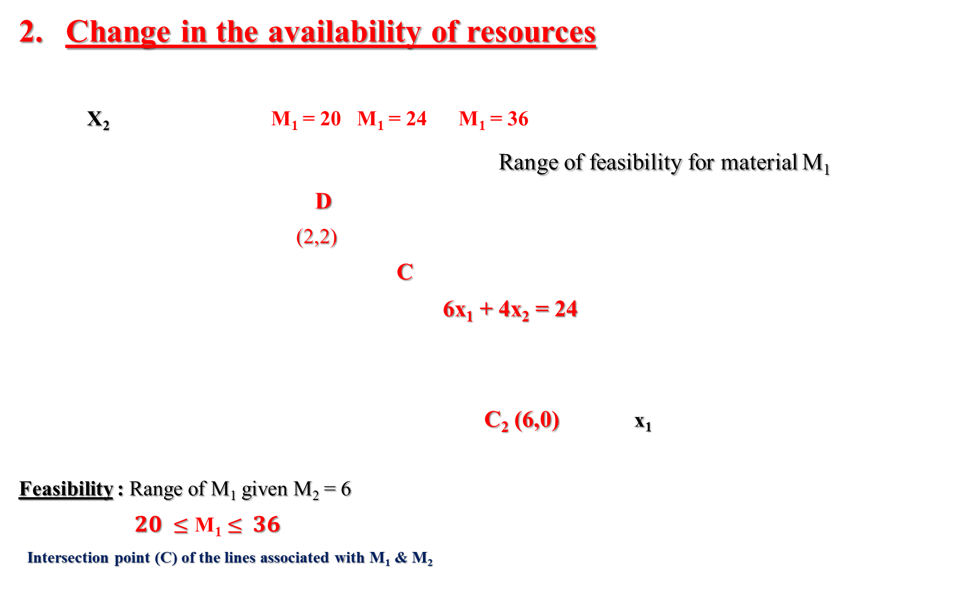
Change in the availability of resources
X₂ M₁ = 20 M₁ = 24 M₁ = 36
Range of feasibility for material M₁
D
(2,2)
C
6x₁ + 4x₂ = 24
C₂ (6,0) x₁
Feasibility : Range of M₁ given M₂ = 6
$20$ $≤\text{M}\text{1}≤$ $36$
Intersection point (C) of the lines associated with M₁ & M₂
Optimal value Z will change with the change in RHS

Slide 20
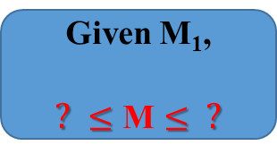

M₂ = 20/3
M₂ = 4 H (8/3,2)
M₂
C
M₁
B (4,0)
Feasibility range for M₂ is
$4$ $≤\text{M}\text{2}≤$ $20/3$
Given M₁,
$?$ $≤\text{M}≤$ $?$

Slide 21

Unit worth of a resource
Model resources Model output Objective value (Z)
Unit worth of resource ‘i’
y_{i} = $\frac{change in value Z}{feasibility range of i}$
LP
Model
Activities

Slide 22
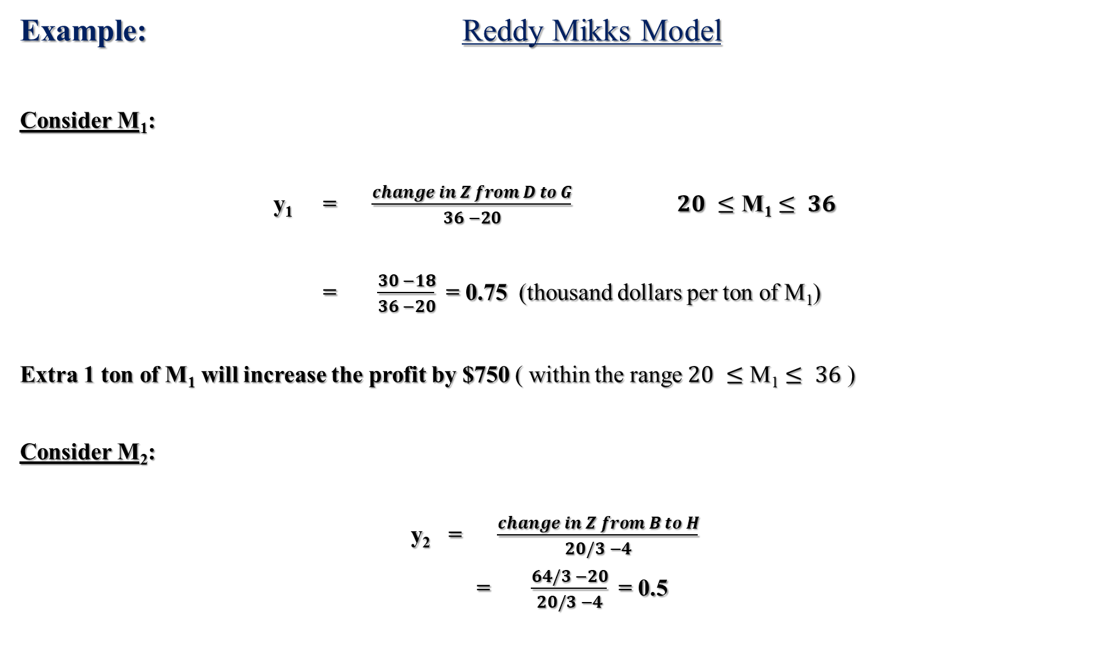
Example: Reddy Mikks Model
Consider M₁:
y₁ = $\frac{change in Z from D to G}{36 −20}$ $20$ $≤\text{M}\text{1}≤$ $36$
= $\frac{30 −18}{36 −20}$ = 0.75 (thousand dollars per ton of M₁)
Extra 1 ton of M₁ will increase the profit by $750 ( within the range $20$ $≤\text{M}\text{1}≤$ $36$ )
Consider M₂:
y₂ = $\frac{change in Z from B to H}{20/3 −4}$
= $\frac{64/3 −20}{20/3 −4}$ = 0.5

Slide 23
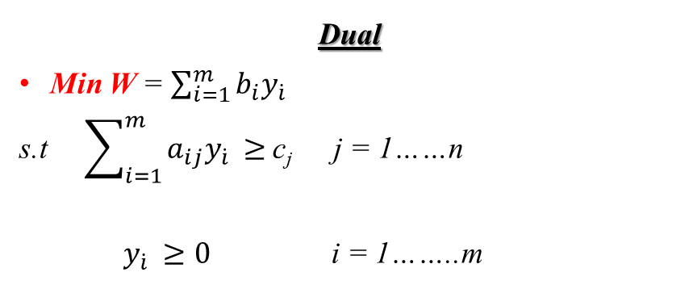


Economic Interpretation of Duality
Dual
Min W = $\sum_{i=1}^{m}{b_{i}y_{\dot{i}}}$
s.t $\sum_{i=1}^{m}{a_{ij}y_{\dot{i}}}$ $≥$c_{j} j = 1……n
$y_{\dot{i}}$ $≥0$ i = 1……..m
Max Z = $\sum_{j=1}^{n}{c_{j}x_{\dot{j}}}$
s.t $\sum_{j=1}^{n}{a_{ij}x_{\dot{j}}}$ $≤$ b_{i} i = 1……m
$x_{\dot{j}}$ $≥0$ j = 1……..n
Z = W Strong Duality
Z $≤W$ Weak duality

Slide 24

$\sum_{j=1}^{n}{c_{j}x_{\dot{j}}}$ = $\sum_{i=1}^{m}{b_{i}y_{\dot{i}}}$
$profit = units of resource x $ per unit
(worth)
Shadow price
Dual price
Z < W
profit < worth of resources
unstable system input exceeds output
Z = W
profit = worth of resources
stable system

Slide 25
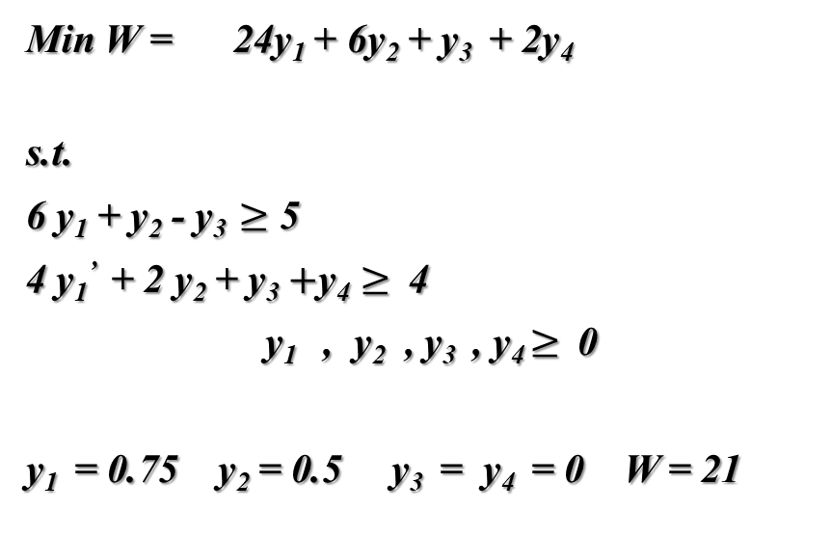
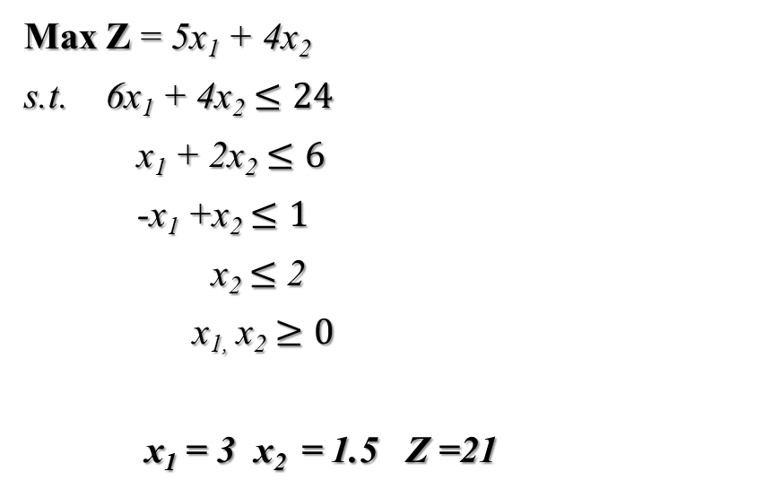
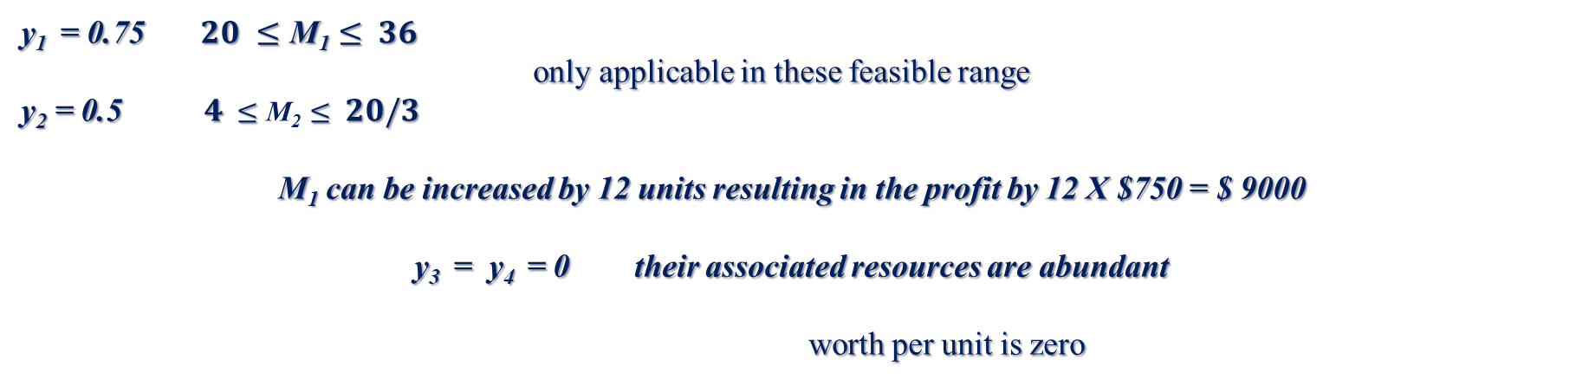
Max Z = 5x₁ + 4x₂
s.t. 6x₁ + 4x₂ $≤24$
x₁ + 2x₂ $≤6$
-x₁ +x₂ $≤1$
x₂ $≤$ 2
x_{1,} x₂ $≥0$
x₁ = 3 x₂ = 1.5 Z =21
Min W = 24y₁ + 6y₂ + y₃ + 2y₄
s.t.
6 y₁ + y₂ - y₃ $≥$ 5
4 y₁’ + 2 y₂ + y₃$+\text{y}\text{4}≥$4
y₁ , y₂ , y₃ , y₄ $≥$ 0
y₁ = 0.75 y₂ = 0.5 y₃ = y₄ = 0 W = 21
y₁ = 0.75 $20$ $≤\text{M}\text{1}≤$ $36$
only applicable in these feasible range
y₂ = 0.5 $4$ $≤\text{M}\text{2}≤$ $20/3$
M₁ can be increased by 12 units resulting in the profit by 12 X $750 = $ 9000
y₃ = y₄ = 0 their associated resources are abundant
worth per unit is zero

Slide 26
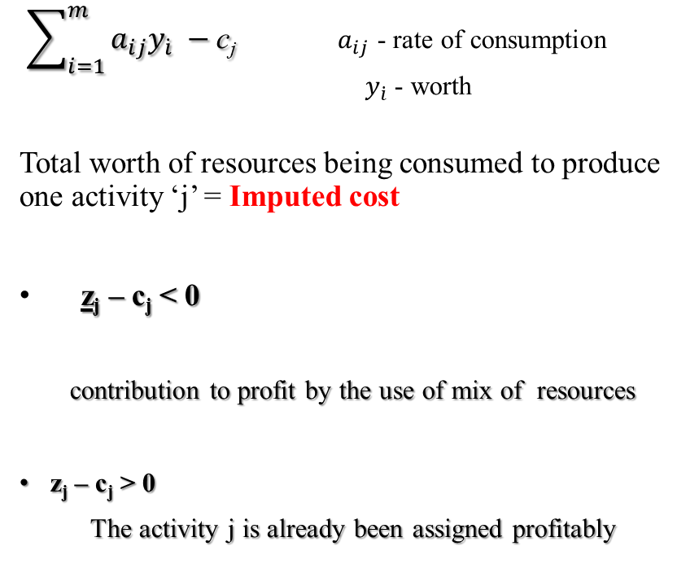
Economic interpretation of Dual constraint
$\sum_{i=1}^{m}{a_{ij}y_{\dot{i}}}$ $−$c_{j} $a_{ij}$ - rate of consumption
$y_{\dot{i}}$ - worth
Total worth of resources being consumed to produce one activity ‘j’ = Imputed cost
z_{j} – c_{j} < 0
contribution to profit by the use of mix of resources
z_{j} – c_{j} > 0
The activity j is already been assigned profitably
Revised Simplex
yA – c
z_{j} – c_{j} Reduced cost
z_{j} < c_{j} imputed cost < profit
The activity j can be initiated to make more profit

Slide 27
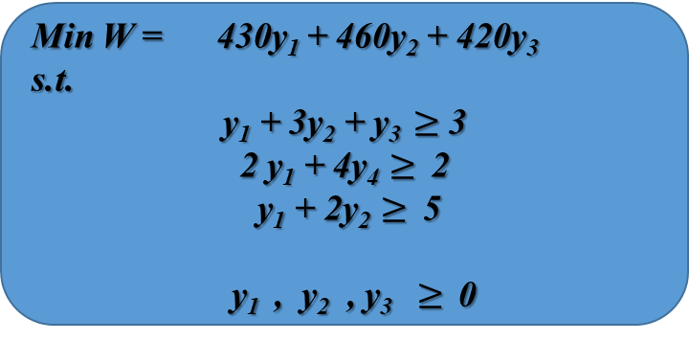

Example:
TOYCO. | Trains | Trucks | Cars | Daily availabilities
 |  |  |  | (in minutes)
Op1 | 1 | 2 | 1 | 430
Op2 | 3 | 0 | 2 | 460
Op3 | 1 | 4 | 0 | 420
Profits ($) | 3 | 2 | 5
Max Z = 3x₁ + 2x₂ + 5x₃
s.t. x₁ + 2x₂ + x₃ $≤430$
3x₁ + 2x₃$≤460$
x₁ + 4x₂ $≤420$
x₁ , x₂ , x₃ $≥0$
Min W = 430y₁ + 460y₂ + 420y₃
s.t.
y₁ + 3y₂ + y₃ $≥$ 3
2 y₁ + 4$\text{y}\text{4}≥$2
y₁ + 2$\text{y}\text{2}≥$5
y₁ , y₂ , y₃ $≥$ 0

Slide 28
Suppose TOYCO wants to produce ToyTrains
Z₁ < c₁
decrease increase
Z₁ = y₁ + 3y₃ + y₃
(1 - r₁) y₁ + (1 – r₂) 3y₃ + (1 – r₃) y₃ < 3
r₁ + 6r₂ > 4
r₁ = r₂ = 0.5 fails
Optimal Solution:
x₁ = 0, x₂ = 100 , x₃ = 230
Z = $1350
Dual Solution
y₁ = 1 , y₂ = 2 , y₃ = 0
W = $1350

Slide 29
The Dual Simplex Method
Dual feasible (Dual Simplex)
Primal feasible (simplex)
Why dual simplex method ?
When many artificial variables are needed to construct a primal feasible solution
Fewer iterations may be needed
Sensitivity analysis
Select entering variable
Select the leaving variable
Stopping condition
Start with a dual feasible solution (eq(0) non-negative, but RHS negative)
Decrease the objective value while retaining dual feasibility (eq(0) > 0)
Stop when RHS is non-negative (Primal feasible)
Dual Simplex: Start with infeasibility and seek feasibility
Primal Simplex: Start with feasibility but non-optimal, seek optimality

Slide 30

Example: Wynder Glass Co.
Max Z = -4y₁ – 12y₂ – 18y₃
s.t. y₁ + 3y₃ $≥3$
2y₂ +2y₃ $≥5$
y₁ , y₂ , y₃ $≥$ 0
 | Z | y₁ | y₂ | y₃ | y₄ | y₅ | RHS
Z | 1 | 4 | 12 | 18 |  |  | 0
y₄ | 0 | -1 | 0 | -3 | 1 | 0 | -3
y₅ | 0 | 0 | -2 | -2 | 0 | 1 | -5
 |  |  | 12/2 = 6 (min.) | 18/2 = 9
0 0

Slide 31
 | Z | y₁ | y₂ | y₃ | y₄ | y₅ | RHS
Z | 1 | 4 | 0 | 6 |  |  | -30
y₄ | 0 | -1 | 0 | -3 | 1 | 0 | -3
y₂ | 0 | 0 | 1 | 1 | 0 | -1/2 | 5/2
 |  | 4/1 =4 |  | 6/3 =2 (min.)
0 6
 | Z | y₁ | y₂ | y₃ | y₄ | y₅ | RHS
Z | 1 | 2 | 0 | 0 |  |  | -36
y₃ | 0 | 1/3 | 0 | 1 | -1/3 | 0 | 1
y₂ | 0 | -1/3 | 1 | 0 | 1/3 | -1/2 | 3/2
2 6
Mirror image of Simplex Method
Optimal

Slide 32

Example
Min Z = 3x₁ + 2x₂
Max –Z
-Z + 3x₁ + 2x₂ = 0
s.t.
3x₁ + 2x₂ $≥3$ x (-1)
4x₁ + 3x₂ $≥6$ x (-1)
x₁ + x₂ $≤3$
x₁, x₂ $≥$ 0
What happens when you have “=” constraints ?

Slide 33
 | x₁ | x₂ | x₃ | x₄ | x₅ | RHS
Z | 3 | 2 | 0 | 0 | 0 | 0
x₃ | -3 | -1 | 1 | 0 | 0 | -3
x₄ | -4 | -3 | 0 | 1 | 0 | -6
x₅ | 1 | 1 | 0 | 0 | 1 | 3
 | ¾ | 2/3 (min)
 | x₁ | x₂ | x₃ | x₄ | x₅ | RHS
Z | 1/3 | 0 | 0 | 2/3 | 0 | -4
x₃ | -5/3 | 0 | 1 | -1/3 | 0 | 2
x₂ | 4/3 | 1 | 0 | -1/3 | 0 | 2
x₅ | -1/3 | 0 | 0 | 1/3 | 1 | 1

Slide 34
 | x₁ | x₂ | x₃ | x₄ | x₅ | RHS
Z | 0 | 0 | -1/5 | -3/5 | 0 | 21/5
x₁ | 1 | 0 | -3/5 | 1/5 | 0 | 3/5
x₄ | 0 | 1 | 4/5 | -3/5 | 0 | 6/5
x₅ | 0 | 0 | -1/5 | 2/5 | 1 | 6/5
3
2
B
C
A
1
2
3

Slide 35

Primal-Dual Simplex
(When both non-optimal and infeasible)
Max Z = 2x₃
s.t. - x₁ + 2x₂ - 2x₃ $≥8$
-x₁ + x₂ + x₃$≤4$
2x₁ – x₂ + 4x₃ $≤10$
x₁ , x₂ , x₃ $≥0$
 | x₁ | x₂ | x₃ | x₄ | x₅ | x₆ | RHS
Z | 0 | 0 | -2 | 0 | 0 | 0 | 0
x₄ | 1 | -2 | 2 | 1 | 0 | 0 | -8
x₅ | -1 | 1 | 1 | 0 | 1 | 0 | 4
x₆ | 2 | -1 | 4 | 0 | 0 | 1 | 10

Slide 36
Remove infeasibility first
 | x₁ | x₂ | x₃ | x₄ | x₅ | x₆ | RHS
Z | 0 | 0 | -2 | 0 | 0 | 0 | 0
x₂ | -1/2 | 1 | -1 | - ½ | 0 | 0 | 4
x₅ | -1/2 | 0 | 2 | ½ | 1 | 0 | 0
x₆ | 3/2 | 0 | 3 | -1/2 | 0 | 1 | 14
Apply Primal simplex to find the optimal solution

Slide 37
Post-optimal or Sensitivity Analysis
Condition resulting from changes
Recommended Action
Current solution remains optimal and feasible
Current solution becomes infeasible
Current solution becomes non-optimal
Current solution becomes non-optimal and infeasible
No further action
Dual Simplex method
Primal Simplex method
Primal-Dual algorithm

Slide 38


TOYCO Optimal
TOYCO Dual
Max Z = 3x₁ + 2x₂ + 5x₃
s.t. x₁ + 2x₂ + x₃ $≤430$
3x₁ + 2x₃$≤460$
x₁ + 4x₂ $≤420$
x₁ , x₂ , x₃ $≥0$
Min W = 430y₁ + 460y₂ + 420y₃
s.t.
y₁ + 3y₂ + y₃ $≥$ 3
2 y₁ + 4$\text{y}\text{4}≥$2
y₁ + 2$\text{y}\text{2}≥$5
y₁ , y₂ , y₃ $≥$ 0
Optimal Solution:
x₁ = 0, x₂ = 100 , x₃ = 230
Z = $1350
Dual Solution
y₁ = 1 , y₂ = 2 , y₃ = 0
W = $1350

Slide 39
450, 460, 400
20
x₂ 450 110
x₃ = B⁻¹ 460 = 230 infeasible
x₆ 400 -40
 | x₁ | x₂ | x₃ | x₄ | x₅ | x₆ | RHS
Z | 4 | 0 | 0 | 1 | 2 | 0 | 1370
x₂ | -1/4 | 1 | 0 | ½ | -1/4 | 0 | 110
x₃ | 3/2 | 0 | 1 | 0 | ½ | 0 | 230
x₆ | 2 | 0 | 0 | -2 | 1 | 1 | -40

Slide 40
 | x₁ | x₂ | x₃ | x₄ | x₅ | x₆ | RHS
Z | 5 | 0 | 0 | 1 | 5/2 | ½ | 1350
x₂ | 1/4 | 1 | 0 | 0 | 0 | ¼ | 100
x₃ | 3/2 | 0 | 1 | 0 | ½ | 0 | 230
x₄ | -1 | 0 | 0 | 1 | -1/2 | -1/2 | 20

Slide 41
Changes affecting feasibility
RHS change:
x_{B} = B⁻¹ b B⁻¹ = matrix associated with the slacks
change
Daily capacity increased by 40% for each line 602, 644, 588
x₂ ½ -1/4 0 602 140
x₃ = 0 ½ 0 644 = 322
x₆ 2 1 1 488 328
Feasible, hence also optimal

Slide 42

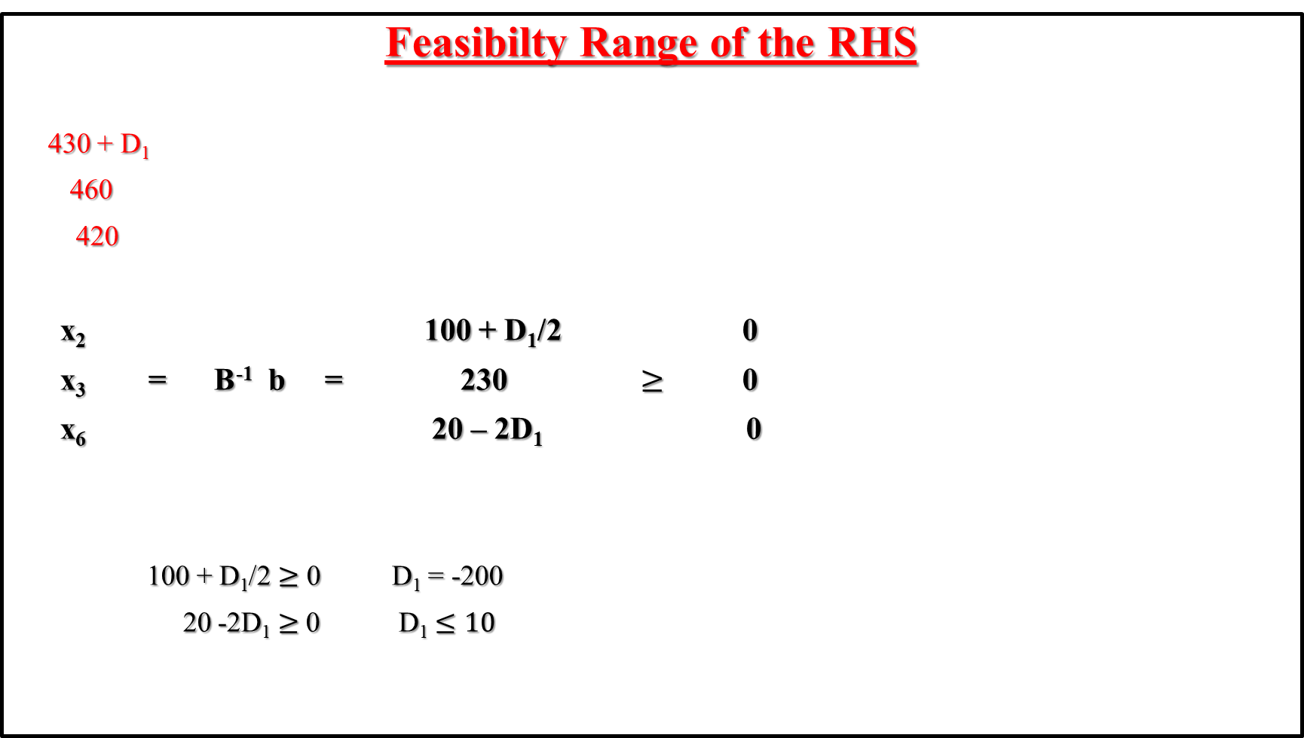
Feasibilty Range of the RHS
430 + D₁
460
420
x₂ 100 + D₁/2 0
x₃ = B⁻¹ b = 230 $≥$ 0
x₆ 20 – 2D₁ 0
100 + D₁/2 $≥$ 0 D₁ = -200
20 -2D₁ $≥$ 0 D₁ $≤10$
Current basis remains optimal
Optimal point lies on the line of another resource constraint
-200 $≤$ D₁ $≤$ 10

Slide 43

230 $≤$ Op1 capacity $≤$ 440
D₁y₁ - jump in the profit
½ -1/4 0
( y₁ y₂ y₃ ) = (2 5 0) 0 ½ 0 = ( 1, 2, 0 )
-2 1 1
y₁ = 1 D₁ = 400 – 430 = -30
D₁y₁ = - $30
y₁ = 1 is valid within -200 $≤$ D₁ $≤$ 10

Slide 44
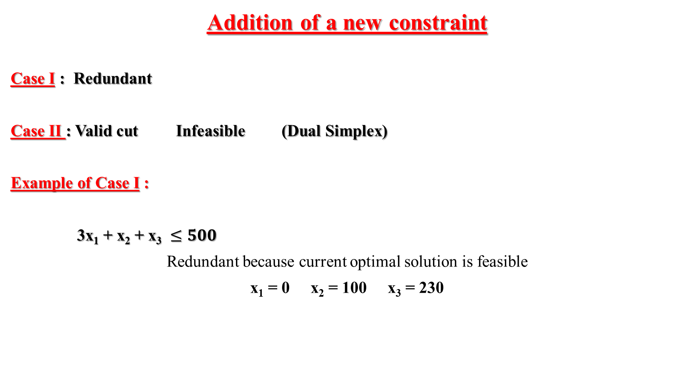
Addition of a new constraint
Case I : Redundant
Case II : Valid cut Infeasible (Dual Simplex)
Example of Case I :
3x₁ + x₂ + x₃ $≤500$
Redundant because current optimal solution is feasible
x₁ = 0 x₂ = 100 x₃ = 230

Slide 45

Example of Case II
3x₁ + 3x₂ + x₃ $≤500$
+ x₇
 | x₁ | x₂ | x₃ | x₄ | x₅ | x₆ | x₇ | RHS
Z | 4 | 0 | 0 | 1 | 2 | 0 | 0 | 1350
x₂ | -1/4 | 1 | 0 | ½ | -1/4 | 0 | 0 | 100
x₃ | 3/2 | 0 | 1 | 0 | ½ | 0 | 0 | 230
x₆ | 2 | 0 | 0 | -2 | 1 | 1 | 0 | 20
x₇ | 3 |  |  | 0 | 0 | 0 | 1 | 500
3
1
Make zero
x₇ | 9/4 | 0 | 0 | -3/2 | ¼ | 0 | 1 | -30
Then apply Dual Simplex
x₁ = 0 x₂ = 90 x₃ = 230 Z = $1330

Slide 46
Changes affecting optimality
Changes in the objective function coefficients
Max 2x₁ + 3x₂ + 4x₃
Thus, c_{B} = (3, 4, 0)
( y₁ y₂ y₃ ) = (3 4 0) B⁻¹ = (3/2, 5/4, 0)
objective coefficients of x₄ x₅ x₆
objective coefficients of:
x₁ NB yA – c y₁ + 3y₂ + y₃ - 2 = 13/4 > 0
x₂ B 0
x₃ B 0
So, the current solution is optimal
Revised Objective value = 2 x 0 + 3x 100 + 4 x 230 = $1220

Slide 47
Suppose,
Max 6x₁ + 3x₂ + 4x₃
verify the objective coefficients
Apply Primal Simplex,
New optimal solution: x₁ = 10 x₂ = 102.5 x₃ = 215 Z = $1227.50
 | x₁ | x₂ | x₃ | x₄ | x₅ | x₆ | RHS
Z | -3/4 | 0 | 0 | 3/2 | 5/4 | 0 | 1220

Slide 48
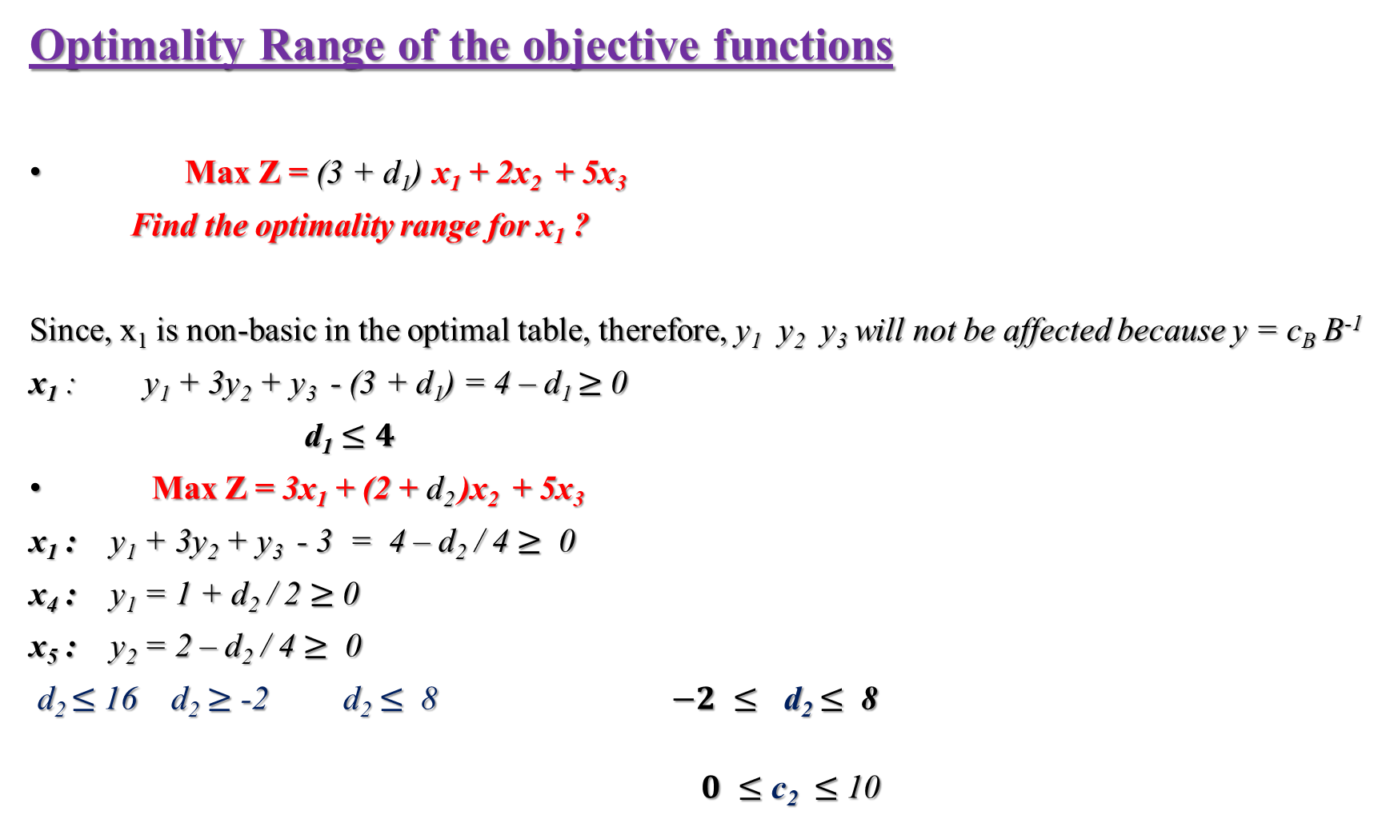
Optimality Range of the objective functions
Max Z = (3 + d₁) x₁ + 2x₂ + 5x₃
Find the optimality range for x₁ ?
Since, x₁ is non-basic in the optimal table, therefore, y₁ y₂ y₃ will not be affected because y = c_{B} B⁻¹
x₁ : y₁ + 3y₂ + y₃ - (3 + d₁) = 4 – d₁ $≥$ 0
d₁ $≤4$
Max Z = 3x₁ + (2 + d₂ )x₂ + 5x₃
x₁ : y₁ + 3y₂ + y₃ - 3 = 4 – d₂ / 4 $≥$ 0
x₄ : y₁ = 1 + d₂ / 2 $≥$ 0
x₅ : y₂ = 2 – d₂ / 4 $≥$ 0
d₂ $≤$ 16 d₂ $≥$ -2 d₂ $≤$ 8 $−2 ≤$ d₂ $≤$ 8
$0 ≤$ c₂ $≤$ 10

Slide 49
Addition of a New activity
A new variable can be thought of a non-basic activity.
Toy train replaced by a Toy fire engine
$4
Op 1 - 1 min
Op 2 – 1 min
Op 3 – 2 min
Reduced cost for x₇ : ( y₁ y₂ y₃ ) = (1 2 0)
1y₁ + 1y₂ + 2y₃ – 4 = -1 so , profitable
x₇ constraint column : objective row : yA – c = -1
constraint rows: B⁻¹ A ½ -1/4 0 1 1/4
0 ½ 0 1 = 1/2
-2 1 1 2 1

Slide 50
 | x₁ | x₂ | x₃ | x₇ | x₄ | x₅ | x₆ | RHS
Z | 4 | 0 | 0 | -1 | 1 | 2 | 0 | 1350
x₂ | -1/4 | 1 | 0 | 1/4 | ½ | -1/4 | 0 | 100
x₃ | 3/2 | 0 | 1 | 1/2 | 0 | ½ | 0 | 230
x₆ | 2 | 0 | 0 | 1 | -2 | 1 | 1 | 20
New optimal solution : x₁ = 0 x₂ = 0 x₃ = 125 x₇ = 210
Z = $1465

